Slide 1
[project/page/product name]
Usability test results and recommendations
Month Year

Slide 2
Executive Summary
Scope: We tested (Product or page), focusing on (tasks, journey) Methods: Unmoderated formative testing with XX participants. We tested X tasks representing typical client actions.
Key findings:
Highlight or issue
Highight or issue
Highlight or issue
Main recommendations:
Recc 1
Recc 2
Recc 3
Screenshot of product/page tested

Slide 3



Methods
XX
participants
Language | Age | Gender | Citizenship | Device | Other | Other
X En X French | 19-65 | X M X W X Other | Non-Canadians only | X mobile X desktop X tablet | (other demographics) | (other demographics)
XX tasks
Find portal landing page
Create account
Log in
Start new application
Save application
Unmoderated testing
Formative testing
Goal: Identify usability issues

Slide 4
Overall results
XX%
Overall task success
Summary:
Highlight: (talk about what worked well; good user feedback; things to continue)
Key issue(s): (talk about where things went wrong, what needs attention or improvement)
XX
Participants who did (insert key behaviour here)
XX
Other metric

Slide 5
Highlight or Issue slide (duplicate as many times as needed)
Highlight or Issue
Text describing highlight or issue, e.g. ‘During the Create an Account task, 5 participants struggled to find the Sign Up button. This is likely due to (design issue)
Screenshot of highlight or issue
Recommendation
Text describing a fix to the design issue, e.g. ‘Making the Sign Up button bigger and placing it in the conventional top right corner of the screen will likely make it more findable’
P1: quote quote quote

Slide 6
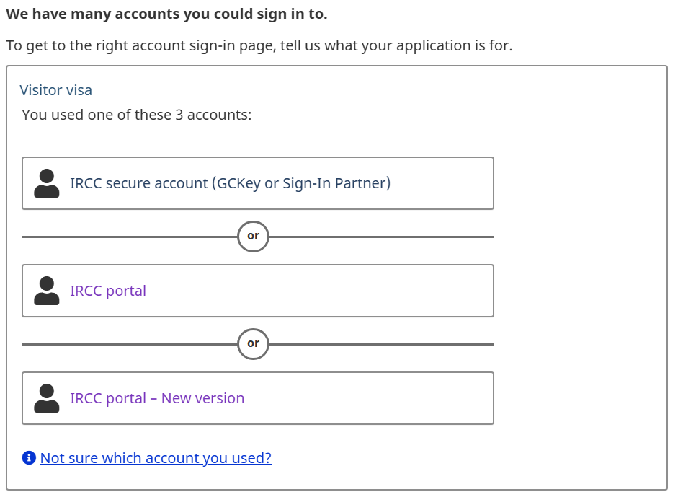
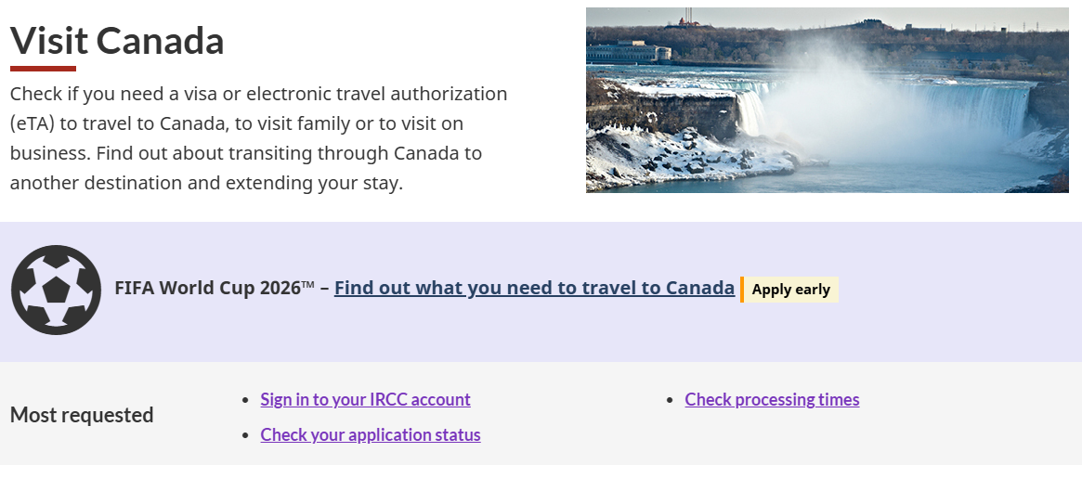
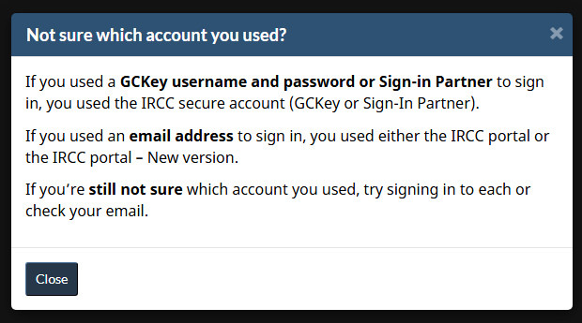
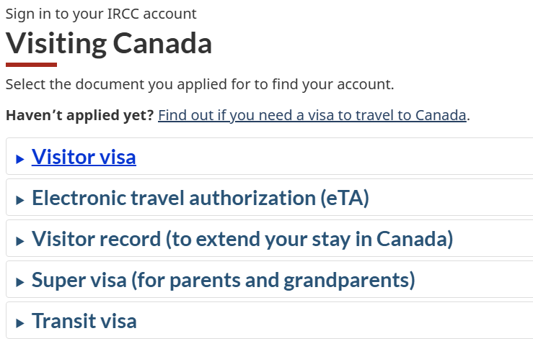
Example of a more visual slide for explaining a more complex issue
Brief description of issue and impact on users
Title describing issue shown in screenshots
Title describing issue shown in screenshots
Recommendation:

Slide 7
Summary of recommendations
Summarize top recommendation 1
Summarize top recommendation 2
Summarize top recommendation 3
Screenshot of highlight or issue
Hopeful text about improving the design for all

Slide 8
Appendix

